Slide 1


V
Introduction SAP UI5
Thank you
November 2016
Vijay Kalluri(482004)

Slide 2
Agenda
Model and Data Binding Types
© 2016, Cognizant Technology Solutions. Vijay Kalluri(482004)

Slide 3
Model
A model in the Model View Controller concept
Model Holds the data and retrieve the data from the database and to set and update data in UI Level.
SAPUI5 provides the following predefined models:
OData model
  OData model is a model based on a OData Service which a REST based model.
  The ODataModel is a server-side model, so the whole dataset is only available on the server
  When you bind a control to an OData model , it comes with many features out of the box such as filtering capability, sorting, pagination etc
  Using SAP NetWeaver Gateway you can expose SAP ERP data in form of OData service and which can be easily consumed in UI5.
  It is used for large Set of Data.
JSON Model(JavaScript Object Notation)
  JSON model is client side model based on JSON data to be used for small set of data.
XML model (Extensible Markup Language)
  A client-side model intended for small data sets, which are completely available on the client
Resource model
  Its Client-Side Model
  Designed to handle data in resource bundles, mainly to provide texts in different languages. The resource model only supports one-time binding mode because it deals with static texts only.
© 2016, Cognizant Technology Solutions. Vijay Kalluri(482004)

Slide 4
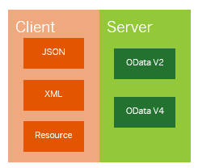
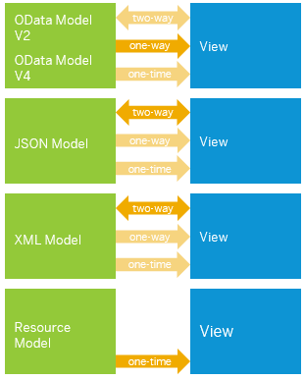
Model
© 2016, Cognizant Technology Solutions. Vijay Kalluri(482004)

Slide 5
Model
SAPUI5 provides the following binding modes:
•One Way:
  One-way binding means a binding from the model to the view; value changes in the model update all corresponding bindings and the view
•Two Way:
  Two-way binding means a binding from the model to the view and from the view to the model; value changes in the model and in the view update all corresponding bindings and the view and model, respectively
•One Time:
  One-time binding means from model to view once.
The following table shows, which binding modes the respective binding models support:
Model | One-way | Two-way | One-time
OData model | X (default) | X | X
JSON model | X | X (default) | X
XML model | X | X (default) | X
Resource model | -- | -- | X
The resource model only supports the one-time binding mode because it deals with static texts only from .properties file.
© 2016, Cognizant Technology Solutions. Vijay Kalluri(482004)

Slide 6
JSON Model(JavaScript Object Notation)
To instantiate a JSON model, use the following code:
var oModel = new sap.ui.model.json.JSONModel();
After the instance has been created, there are different options to get the data into the model.
The easiest option is to set data by using the setData method:
oModel.setData({ firstName: "Peter", lastName: "Pan"});
oModel.loadData("data.json");
The following example shows a simple JSONModel with the different binding paths:
{
company: {
name: "Treefish Inc", info: {employees: 3},
contacts: [
{ name: “Vijay Kalluri", phone: "873“ },
{ name: “Banerjee, Joyitha",phone: "734" },
{ name: "Manchaiah, Shekar", phone: "275"}
]
}
}
Absolute binding paths within this model:
  /company/name
  /company/info/employees
  /company/contacts
Relative binding paths within the "/company" context:
  name
  info/employees
  contacts
Relative binding paths within an aggregation binding of "/company/contacts":
  name
  phone
© 2016, Cognizant Technology Solutions. Vijay Kalluri(482004)

Slide 7
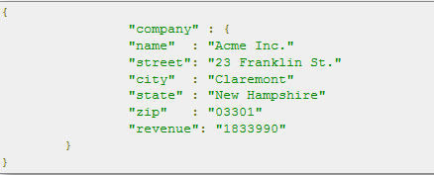
Data Binding
SAPUI5 supports three different binding types:
  Property binding,
  Aggregation binding
  Element binding.
Property Binding
  Property binding allows properties of the control to get automatically initialized and updated from model data.
Property Binding can be done by three ways.
  Within curly brackets in the constructor
  By bind property method
  By path
For Example
© 2016, Cognizant Technology Solutions. Vijay Kalluri(482004)

Slide 8
Data Binding
• Within curly brackets in the constructor
XML: <Input value="{/company/name}" />
JS: var oInput = new sap.m.Input({value: "{/company/name}"});
• By bind property method
Depending on the use case, it may be useful to define the binding at a later time, using the bindProperty method:
oInput.bindProperty("value", "/company/name");
• By path
XML
<Input value="{ path:'/company/name', mode: 'sap.ui.model.BindingMode.OneWay' }"/>
JS:
var oInput = new sap.m.Input ({ value: { path: "/company/name", mode: sap.ui.model.BindingMode.OneWay}});
© 2016, Cognizant Technology Solutions. Vijay Kalluri(482004)

Slide 9
Data Binding
• Aggregation Binding
Aggregation binding is used to automatically create child controls according to model data.
Let’s say we would like to display the following JSON model data in a sap.m.List:
The List element has both an items attribute and a nested items element:
The attribute items="{/ empDetails}" binds root element of our JSON model’s
The nested items element in our case contains a StandardListItem. This template for creating the individual list rows.
Usually we are going to use Aggregation Binding for display data into the sap.m.Table, sap.m. StandardListItem etc….
Using Aggregation Binding we will get bulk data from the Model. Then we need to add the data into for Exp: table rows using UI Element Property
Where we are going to bind?
if property type is String. There we are doing to Bind
© 2016, Cognizant Technology Solutions. Vijay Kalluri(482004)

Slide 10
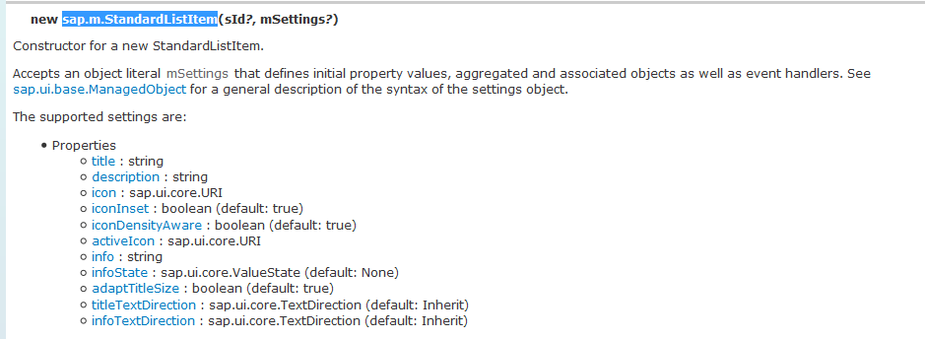
Data Binding
© 2016, Cognizant Technology Solutions. Vijay Kalluri(482004)

Slide 11

Question & Answers

Slide 12
Thank You

